Slide 1
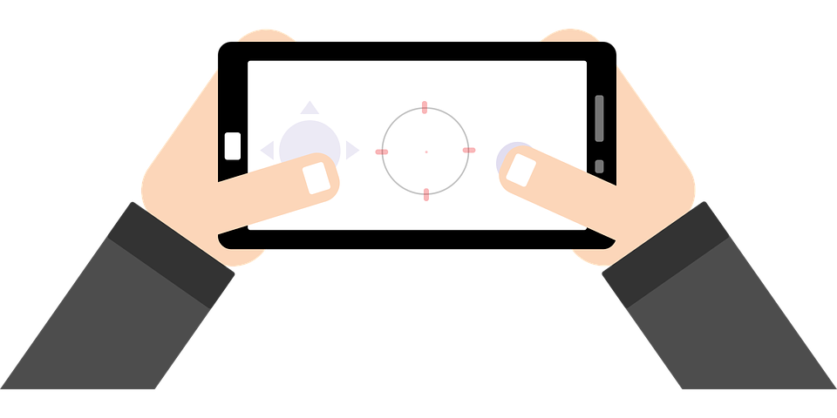
Smart City Shreveport App Proposal
By:
Sarah Hoffman, Scottie Horne, Aaliyah Phillips, Aparna Chellapilla, Pradhi Kohli
March 22, 2021

Slide 2
Executive Summary
Mobile platforms is changing the way companies conduct business and it is time that SmartApp Inc. introduce new mobile app.
We propose a new mobile applications package that includes easy access to local city weather, maps, hotel and restaurant reservations, festivals and sign up for newsletters.
This proposal presents a comprehensive marketing plan for this mobile app and make it convenient and inclusive to the needs and demands of the consumer.
The target market includes people who are current residents or new tourists to Shreveport.
We plan to launch it within 8 months and provide continuous improvements every 6 months.
Over time we can also enhance to include other cities.

Slide 3

Agenda
What is Smart City App
Problems Addressed
Solution addressed by the Shreveport Smart City App
Project Objective
SWOT Analysis
Target Market
Timeline
Financials
Future (Scope) Planned Enhancements
Our Team

Slide 4

What is Smart City App
SmartApp Inc. app highlights the various features around Shreveport.
We are going to introduce new mobile applications package that includes easy access to
local city weather and maps
Hotel and restaurant reservations
Festivals and Entertainment
Sign up for newsletters
The new mobile apps package will be introduced in the United States and will mainly target tourists along with ordinary individuals that have smart phones, personal digital assistants, tablets, and other smart gadgets.
This proposal presents a comprehensive marketing plan for this mobile app.

Slide 5
Problems addressed
# 1 Connectivity
# 2 Providing Local info/deals
# 3 Planning for weather/time constraints
Tourists often have trouble accessing all the relevant information at the same time about the location they are visiting.
Most tourists want reliable and inexpensive deals for hotels, restaurants and places to visit.
Tourist have a limited time frame in which they can explore most of the destinations they are exploring.

Slide 6
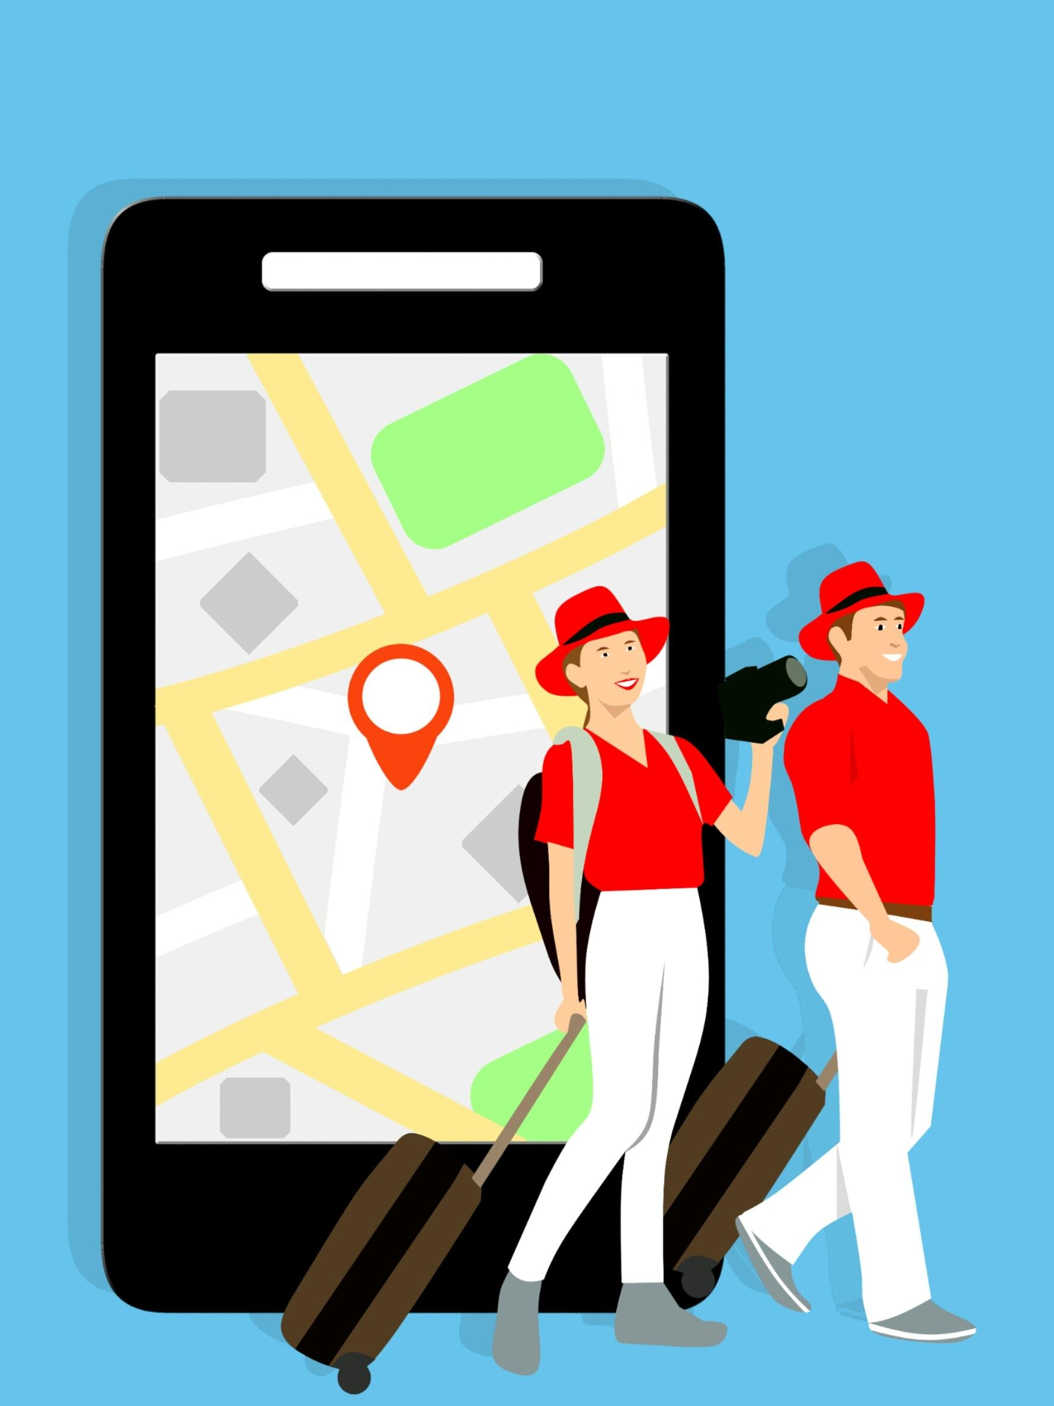
Solution addressed by the Shreveport Smart City App
Invites tourists to visit the local area.
Shows the tourist/newcomer the safest areas to play in while on their holiday.
Brings business to the local Community
User friendly for anyone interested to explore the city.
Gives detailed information to area newcomers/tourists to plan their trips to Shreveport and the surrounding towns.
Presents 7 day local weather to plan for their stay.

Slide 7
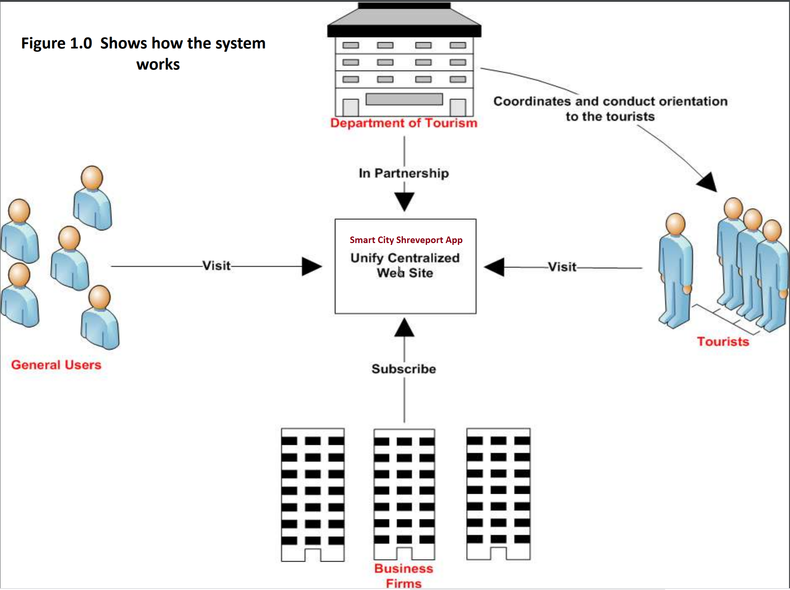

Slide 8
Project objective/Scope of the Shreveport Smart City App
The objective for this project is to create a Shreveport Smart City App that highlights the various information around Shreveport. It displays the weather, dangerous areas to avoid for tourists/newcomers, available good hotels, restaurants, activities and entertainment.

Slide 9

SWOT Analysis
Strengths: Reasonable price, Wide variety of features on a click of a button.
Weakness: Turn down in the economy, start-up cost
Opportunity: Benefit to local businesses
Threats: Google apps

Slide 10
Target Market
The Smart City App is a one stop resource aimed at users searching for information on Local Restaurants , Hotels to stay, Weather and happening places around the city with the latest information.
This got your trip handled either in your town or out of town.
This site aims at connecting the services in your city and displaying them at a mouse click!
It can also highlight local businesses and increase their profits when the services are available to the end-user easily.

Slide 11
Timeline
Apr | May | Jun | Jul | Aug | Sep | Oct | Novl
Deployment
In-production services
Global go-live
Advanced projects
Example 1
Example 2
Notes:
Pre Launch -engage audience, social media
During launch -app review, billboards, radio,
Post launch -data release
Growth Range #5,6,7

Slide 12
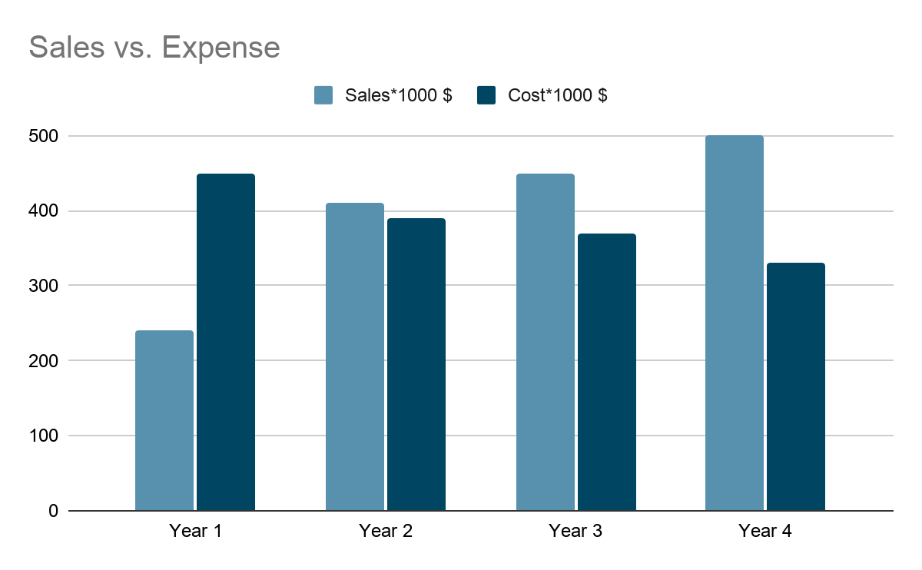
Financials
It is reasonable to assume that given the location, size of operation, and unique concept of this App in Shreveport, that it will produce sales in excess of the existing operation.
The projections set out in this plan, however, are based on a more conservative estimate.
The company will develop a centralized website and from that, the company will convince business firms and tourists spot owners to tie up with the company and advertise their products and services as well as the tourists destination on the internet.
The company will generate income/revenue out from the business firms who made a subscription in the System.

Slide 13
Future (Scope) Planned Enhancements
Safe Feature - This feature displays the safe places in Shreveport by collecting data from SpotCrime https://spotcrime.com/
Smart Transit : Integrate the multimodal transportation feature -- to connect the commuters with real time data and to use the cab-rental or bus or train or Amtrak information and reach their destination seamlessly.
Integrate and update the Local Business(Restaurants and shopping) Information with real time data so it can create more business.
Add an event Calendar to update about happenings in the city.
Add the latest news going on in the city.
CAR PARK information - to display the nearest and free(if any ) car park information to the visitors.
Suggest Tourist Trails to the visitor and let them discover the city .
Building an Android App/ios App with all the site features.

Slide 14
Our Team
Role:
Scrum Master-Sarah
Technical Developer 1 -Pradhi
Technical Developer 2 -Aparna
Front end -Aaliyah
Back end -Scottie Horne

Slide 15
Thank you for taking the time to listen to our presentation of our capstone project today!!

